Slide 1
Contributing to Django
How I learned to stop worrying and just try to fix an ORM Bug

Slide 2
First DjangoCon?
Notes:
How many people are attending their first DjangoCon

Slide 3
Introduction
Notes:
My name is Ryan Cheley and today I’m going to talk about my experience fixing a bug in the Django ORM
When I was 15 (in 1993) my Boy Scout troop did a trip to Mt Whitney.

Slide 4
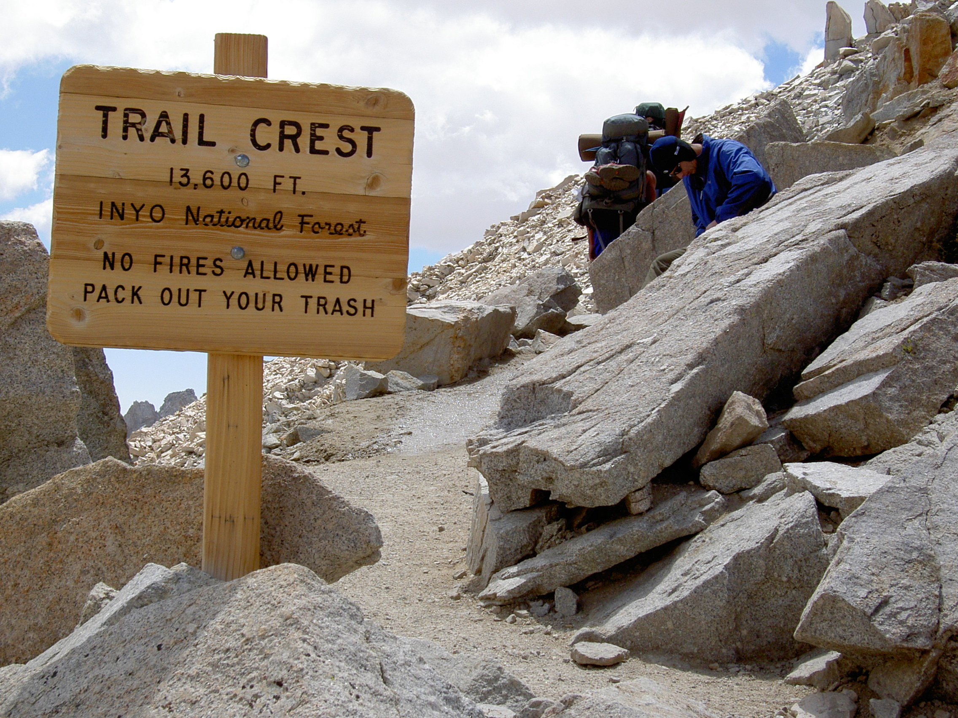
Notes:
And there I was ... at the top of the Mt Whitney Portal, roughly 13.6 ft (4159 m) above sea level
I had spent the 7 days hiking to get here.
I was only 3 miles from the summit of Mt Whitney ... but I wasn't sure I could go any further.
My hiking companions told me I didn't look so good. Truth be told, I didn't feel so good either.
Did I make it to the summit?

Slide 5
Trying to get to DjangoCon US
2018
2019
2020
2021 🧑🏻‍💻
2022 🧍🏻
Notes:
I’ve been trying to make it to DjangoCon US since 2018
2018: But, I had a work conference I had to attend.
2019: It happened again in 2019
2020: I was *determined* to go in 2020 ... but we all know what happened there
2021: I was able to attend the online version in 2021
2022: And then I finally made it in person 2022 … And it was amazing.

Slide 6
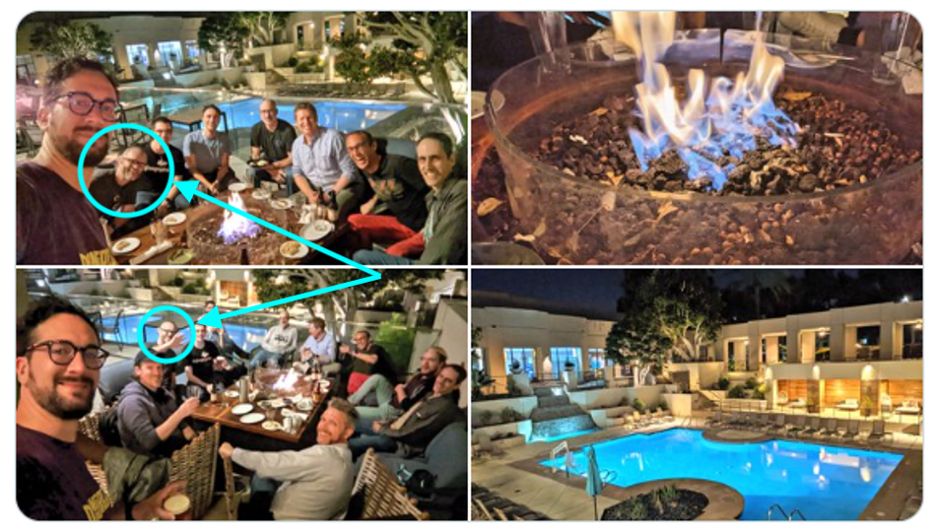
Notes:
You can see me in the pictures on the left … I had *slightly* longer hair then ☺

Slide 7
🏃🏻‍♂️
Notes:
Sprints
I was very excited about attending the sprints and working on *something* ORM related
My strategy for finding a ticket was to find something old, that seemed straightforward(ish) and then just go for it.
I spent some time during the conference trying to find something, and by the day of the sprints I had been able to narrow it down to a single ticket

Slide 8
Criteria
Old?
It was opened in January of 2009
Straightforard(ish)
It’s related to SQLite

Slide 9
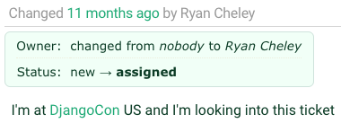
Notes:
I assigned the ticket to myself

Slide 10
🔍
Notes:
Reviewing the Ticket
I spent time reviewing the ticket and then speaking with Simon Charette about it. It seemed as though it wasn't a problem anymore

Slide 11
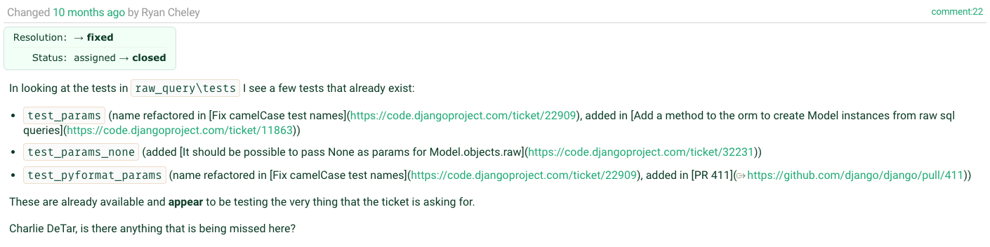
Notes:
And so I added a comment to the ticket

Slide 12
🎉
Notes:
Marking the Ticket as Done!

Slide 13
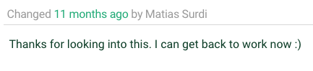
Notes:
A comment on the issue thanking me for working on the ticket … the original reporter for the ticket!

Slide 14
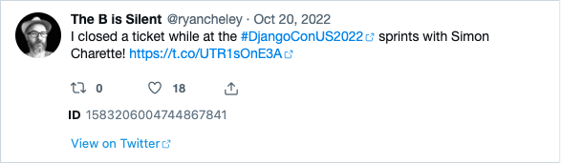
Letting everyone know!
Notes:
I was so excited that I let the world know about it on the bird site

Slide 15
🏠
Notes:
I spent the rest of my time at the sprints working on other non-ORM related tickets in other Django related projects
And I headed home having been able to fix a bug in the ORM!!!!
….

Slide 16

Notes:
And I felt *really* good about this

Slide 17
But then …

Slide 18
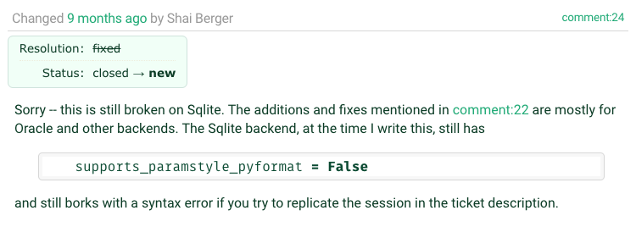
Notes:
Shai Berger is a member of the Django Security team

Slide 19
😩
Notes:
Oh No!
I was faced with two potential choices:

Slide 20
🙈🙉🙊
Notes:
Ignore the bug. It had been a bug for YEARS … it was opened on January 19, 2009 (13 YEARS!!!!) and didn’t seem to have caused any MAJOR issues

Slide 21
🛠️
Notes:
Fix
Try to work it on my “own”

Slide 22
Feelings …
Notes:
I also had lots of feelings surrounding the discovery of the bug still existing

Slide 23
😳
Notes:
Embarrassed
I declared it fixed on the Bird Site
I had people at DjangoCon US 2022 ASK ME HOW I DID IT!

Slide 24
😞
Notes:
Disappointed
I felt like I let people down
I felt like I let *myself* down

Slide 25
😨
Notes:
Fear
Imposter Syndrome – Can I work on this on “my own”

Slide 26
Community
Notes:
Because of a talk that Carlton Gibson gave at DjangoCon US 2018 “Your Framework Needs You”, I decided to give it a shot, even though I would be on my own mostly

Slide 27
Your Web Framework Needs You!
Ticket difficulty
The Review Process can be challenging
You can do it!
Notes:
Add top 3 points from Carlton’s talk here:
1. The vast majority of tickets are no harder than the work you do to solve every single day using Django
2. Yes they need, time, thought, and a little bit of your love
3. If you get stuck while trying to solve it you can ask for help!
4. The review process is hard
… and everyone gets the same review process;
it’s not personal
5. You can do it.
You are qualified!
If you’ve spent time working on an issue you are

Slide 28
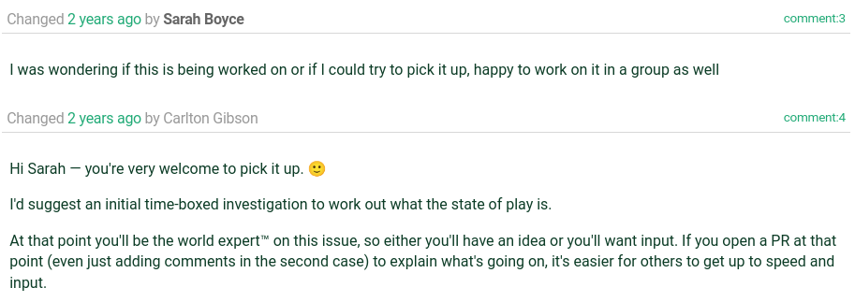
The World’s Foremost Expert

Slide 29
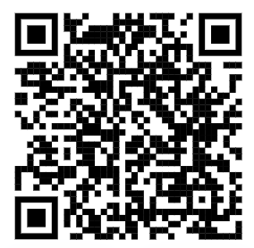
Notes:
Add top 3 points from Carlton’s talk here:
1. The vast majority of tickets are no harder than the work you do to solve every single day using Django
2. Yes they need, time, thought, and a little bit of your love
3. If you get stuck while trying to solve it you can ask for help!
4. The review process is hard … and everyone gets the same review process; it’s not personal
5. You can do it. You are qualified! If you’ve spent time working on an issue you are
6. Other repos to contribute to
7. Other tasks: docs, ops, security
8. Help smooth the on-ramp
9. Change needs to come from the community

Slide 30
Working on the Ticket
Notes:
I went to work on the ticket and did what most of us do when we’re assigned a Bug for work, or on a personal project

Slide 31
Replicate the Bug
Read some docs
Write some code
Test the Code

Slide 32
1. Replicate
Notes:
Replicate the Bug

Slide 33
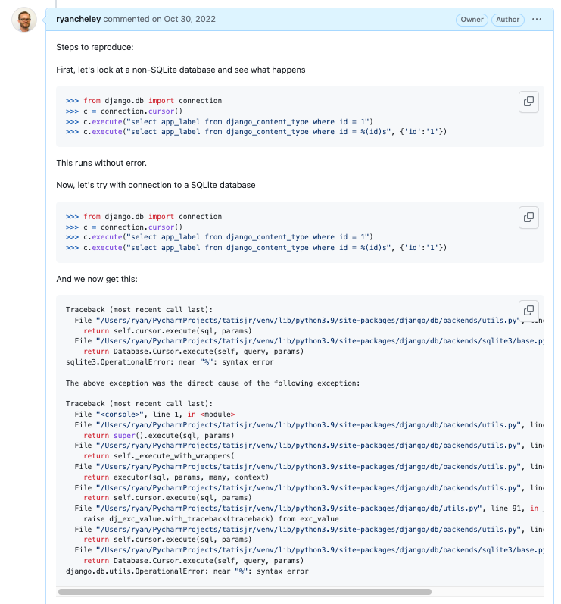

Slide 34
2. Read
Notes:
Read some docs

Slide 35
3. Write
Notes:
Write some code

Slide 36
Details to be added
Notes:
Screenshots of conversation up to here

Slide 37
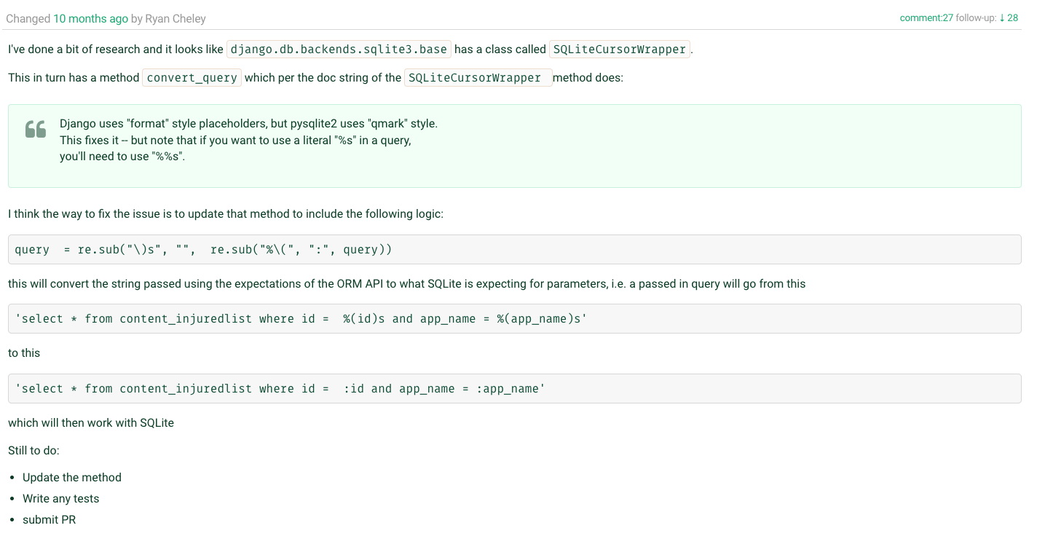

Slide 38
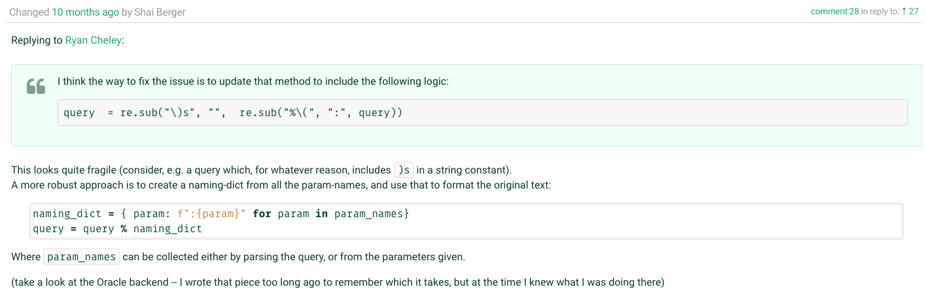

Slide 39
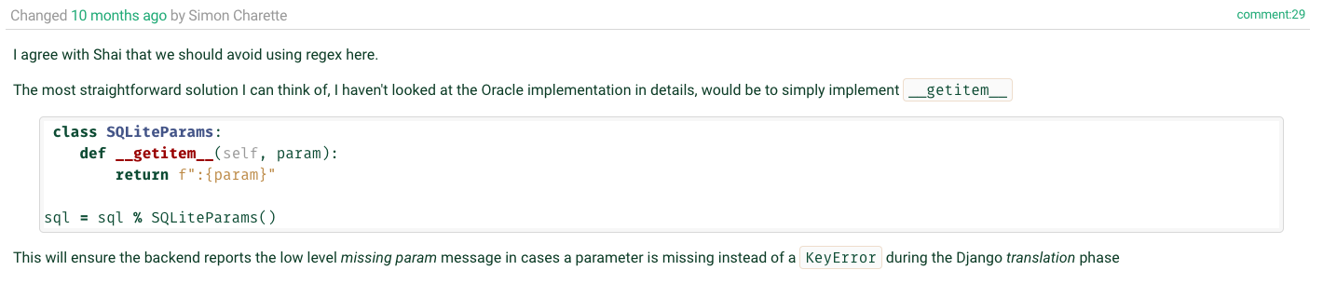

Slide 40
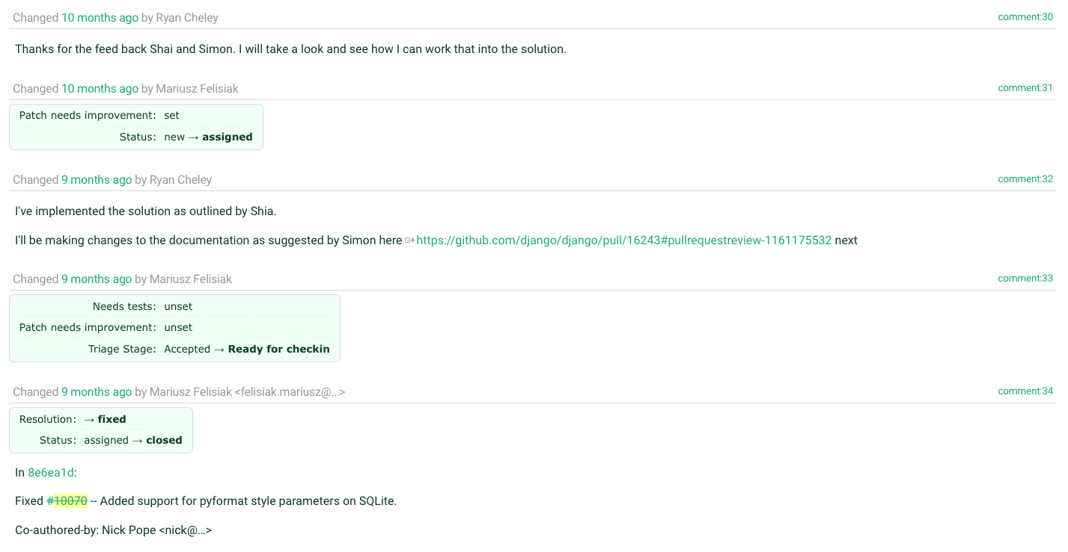

Slide 41
4. Test
Notes:
Test the code that you wrote

Slide 42
Testing Hypothesis Matrix
 | Flag = False | Flag = True
Original Code | N-1 Tests Should pass 1 test should be skipped | N-1 Tests Should pass 1 test should fail
Updated Code | N-1 Tests Should pass 1 test should be skipped | All tests should pass
*Flag = supports_paramstyle_pyformat

Slide 43
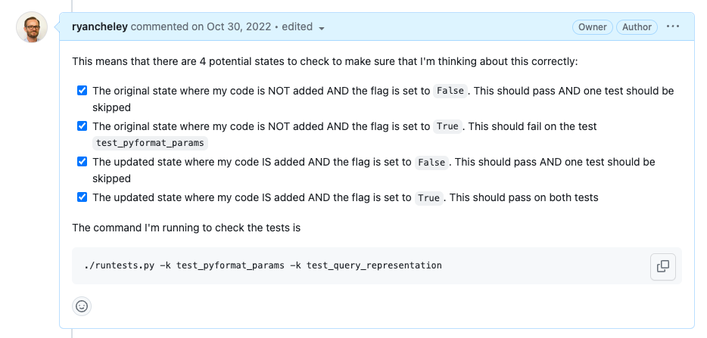
Notes:
Four States to check
The original state where my code is NOT added AND the flag is set to False. This should pass AND one test should be skipped
The original state where my code is NOT added AND the flag is set to True. This should fail on the test test_pyformat_params
The updated state where my code IS added AND the flag is set to False. This should pass AND one test should be skipped
The updated state where my code IS added AND the flag is set to True. This should pass on both tests

Slide 44
5. Write
Notes:
Write down what you’re learning as you’re learning … because we all do this, right?
I didn’t, until I saw this talk by Simon Willison at DjangoCon US 2022 titled, “Massively increase your productivity on personal projects with comprehensive documentation and automated tests”

Slide 45
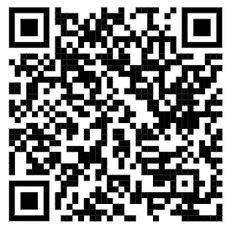
Public Notes
Notes:
At DjangoCon 2022 Simon Willison gave a great talk which included an idea called ‘public notes’. I highly recommend watching that talk and implementing the public notes idea
This was the first time I used the idea, but I've used it a few more times since then as I try to learn about a thing. I’ve even started doing it at my joby-job
Essentially you use an issue (in this case a GitHub issue) as a spot to work through a problem and leave yourself breadcrumbs for what you’ve tried and learned, basically doing what you would do in the ‘scientific method’

Slide 46
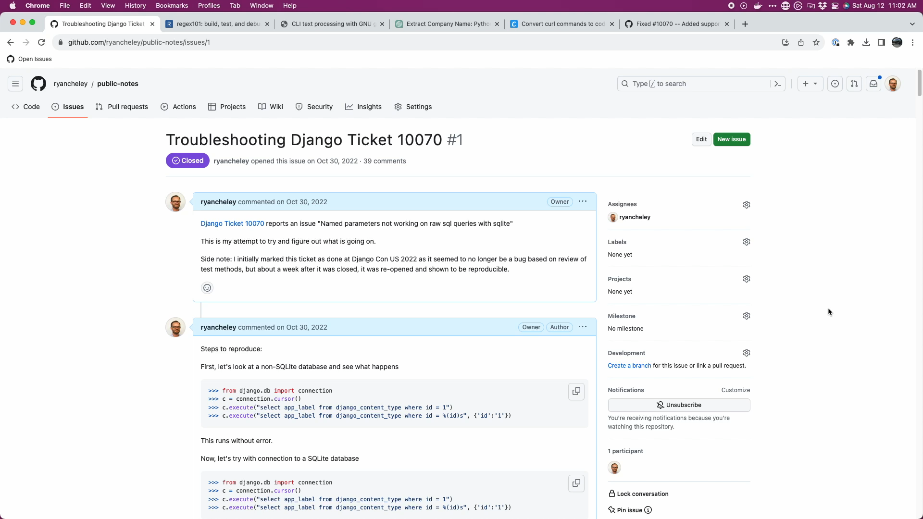
Notes:
40 comments as a conversation to myself, back and forth from Oct 30, 2022 to Nov 8, 2022 (10 days!)

Slide 47
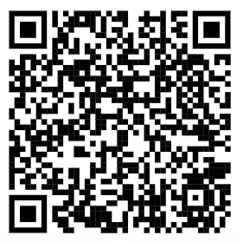
My Public Notes
Notes:
In my notes there’s a lot of back and forth, two steps backward, 1 step forward kind of things, but even looking at it now, I can see my thought process for how the bug ended up getting fixed

Slide 48
The fix
Notes:
Ultimately the fix was made, but it wasn’t just *me*. I had a lot of help in getting the code to the right spot.
Nick Pope
Shia Berger
Simon Charette
Mariusz Felisiak

Slide 49

Nick Pope

Slide 50
Remove Code Duplication
%(value)s to :value
generators
Notes:
There is duplication which should be pushed down into .convert_query().
Converting %(value)s to :value in this way will also convert %%s to %s which will then be incorrectly converted to ? in .convert_query(). We should not perform both conversions¹ and a test should be added to ensure this doesn't happen.
Converting param_list to a list in .executemany() will saddle us with poor performance. We many have been passed a generator and the current approach will force all of the parameters to be materialized. The approach needed requires that we can peek at the first item in the generator without consuming the lot.

Slide 51
Shia Berger

Slide 52
Identified fragility
Notes:
Feedback that the approach had some fragility https://code.djangoproject.com/ticket/10070#comment:28
with Simon Charette agreeing https://code.djangoproject.com/ticket/10070#comment:29
And that regex should be avoided

Slide 53

Simon Charette

Slide 54
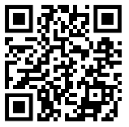
Gave great Keynote at DjangoCon US 2022 on the State of the ORM
Awesome primer on ORM at Sprints
Update to the docs!
Notes:
He gave a great keynote at DjangoCon US 2022
And an awesome primer on the ORM in general at the sprints
Remember to update the docs!

Slide 55

Mariusz Felisiak

Slide 56
Simplified comments
Merged the PR

Slide 57
Lessons
Notes:
The ORM can seem big and scary
The code for Django can seem big and scary

Slide 58
The Django ORM …

Slide 59
Is Python

Slide 60
In fact, all of Django …

Slide 61
Is Python

Slide 62
Looking at Tickets
Notes:
So when you go to look for a ticket to take, remember that there is an amazing community here that wants to see you succeed …

Slide 63
Look At
Read
Write
Notes:
and at the end of the day the code you’re going to look at, read, and write

Slide 64
Is Python

Slide 65
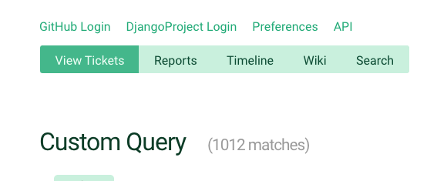
Notes:
So when you’re ready to dive in to one of the currently <> open tickets, just keep that in mind

Slide 67
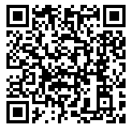
Trac
Notes:
And because this is Django, there is great documentation on how to triage tickets and work through them

Slide 68
Notes:
Back to Mt Whitney
I was **only** three miles from the summit, but I just wasn’t feeling **it**.
My fellow hikers didn’t discourage me from continuing, but they didn’t really encourage me either.
I didn’t make it to the summit that day and it’s been a regret kind of ever since. I’ve not done a big hike like that since.
But why am I telling this story? What does this have to do with fixing a bug in the Django ORM.
When the bug wasn’t resolved I had an option to just give up.
But the community helped me to work through it. The solution that was ultimately submitted and merged wasn’t just mine, it was through the hard work of a couple of different people.
This community wants you to succeed. They want you to learn.
If this community had been up there with me that day, I’m 100% sure that I would have made it to the summit because of the encouragement that is provided and the determination to want **you** to succeed

Slide 69
Thank you

Slide 70
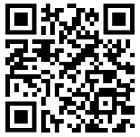
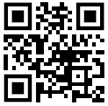
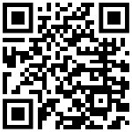
Find me on …
Platform | QR Code
Mastodon https://mastodon.social/@ryancheley
GitHub https://github.com/ryancheley/
LinkedIn https://www.linkedin.com/in/ryan-cheley/

